Slide 1
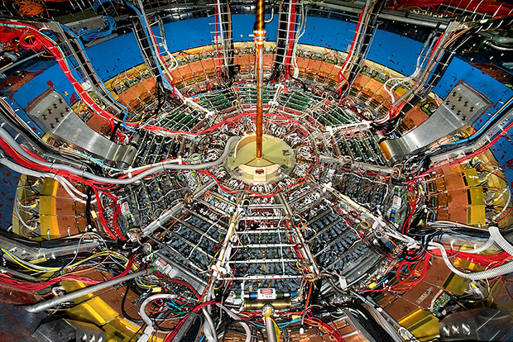
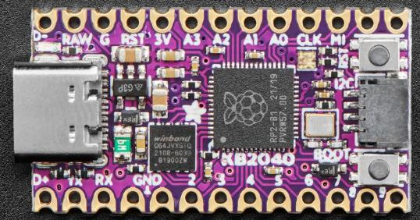
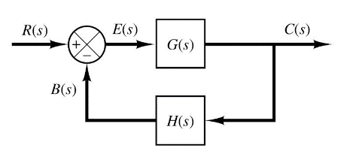

Control Systems
Engineering
(CSE 201)
Student #1
Student #2
Student #3
Team 01
Numpy and Matplotlib
Vectorized Operations

Slide 2
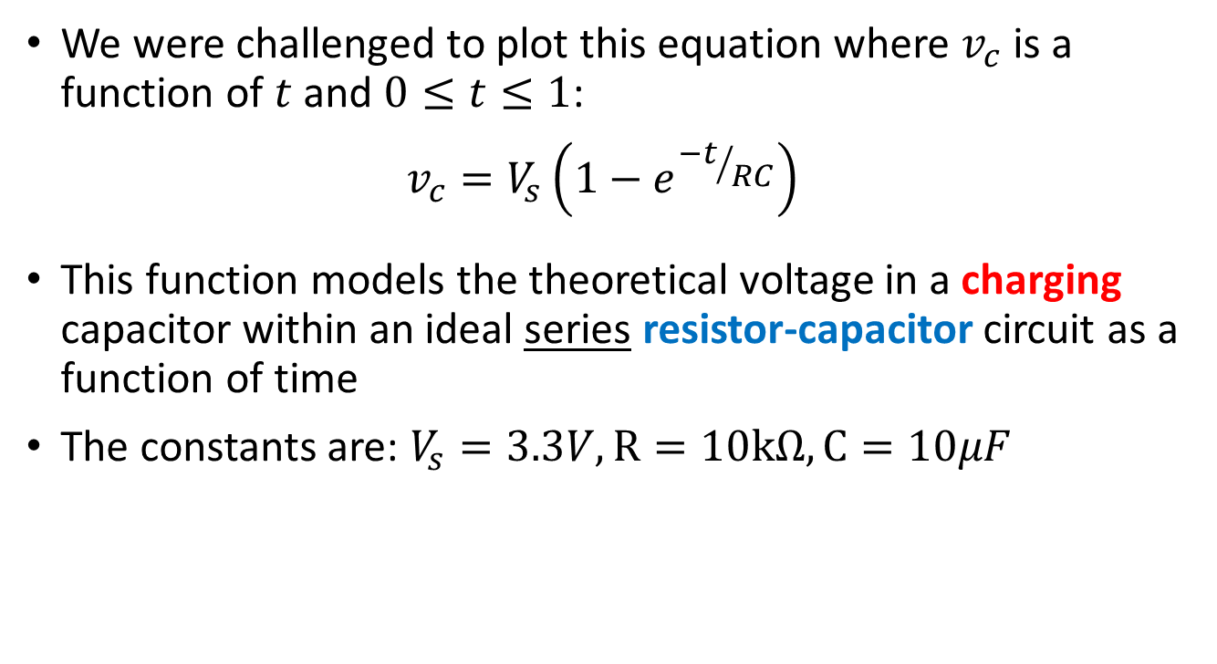
Our Challenge: Model an RC Circuit
We were challenged to plot this equation where $v_{c}$ is a function of $t$ and $0≤t≤1$:
$$v_{c}=V_{s}\left(1−e^{{−t}/{RC}}\right)$$
This function models the theoretical voltage in a charging capacitor within an ideal series resistor-capacitor circuit as a function of time
The constants are: $V_{s}=3.3V, R=10kΩ, C=10μF$

Slide 3
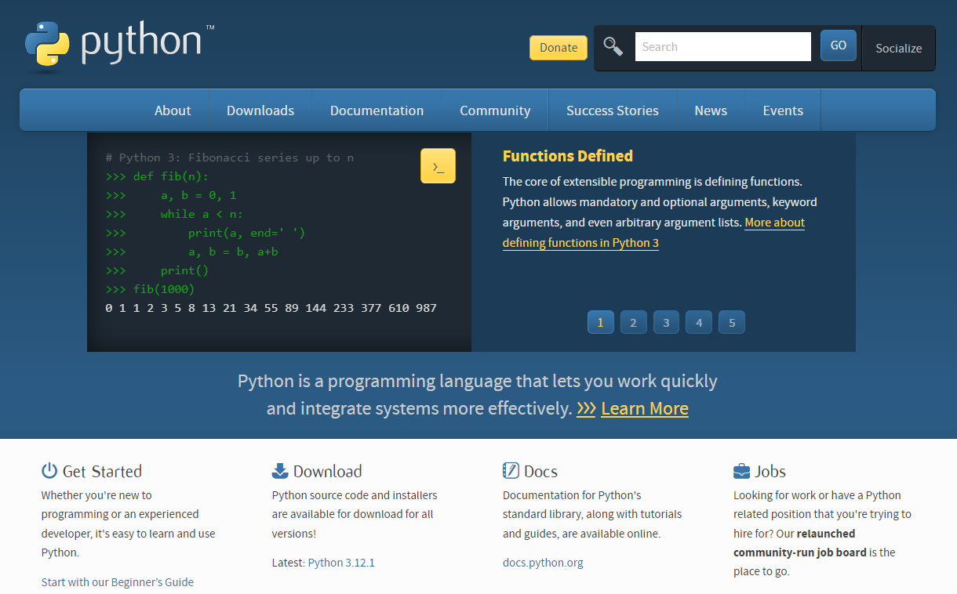

Slide 4
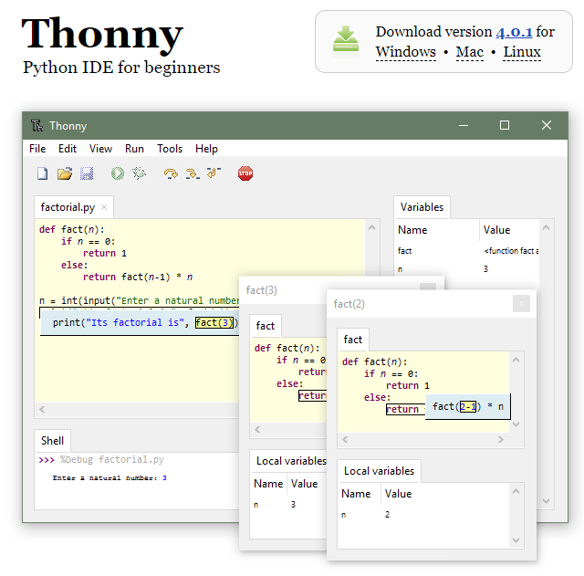

Slide 5

PyPI - The Python Package Index

Slide 6

Installing Python Packages into Thonny
https://numpy.org

Slide 7

https://matplotlib.org

Slide 8
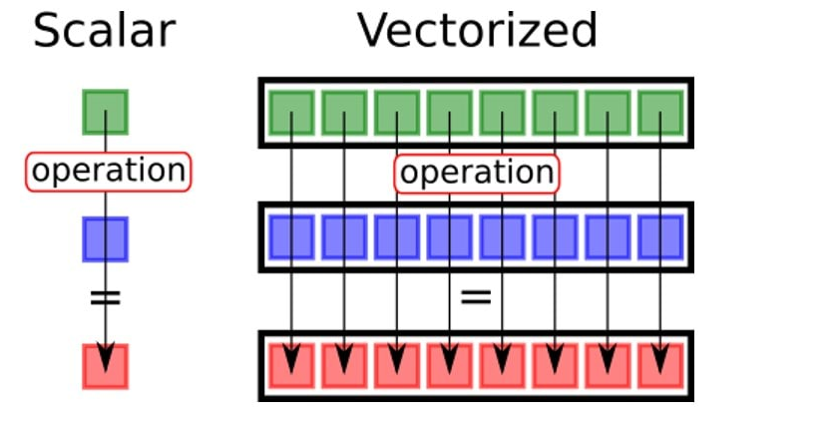
Numpy Vectorized Operations
3
a
*
*
5
b
15
a[n]*b[n]
A vectorized scalar operation applies a function to every element in a single array (to each individual cell)
A vectorized array operation applies a function to elements in both arrays that have the same index value

Slide 9
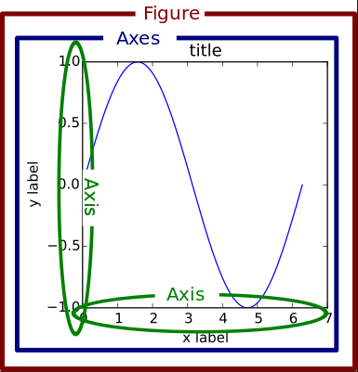
Matplotlib Container Hierarchy

Slide 10
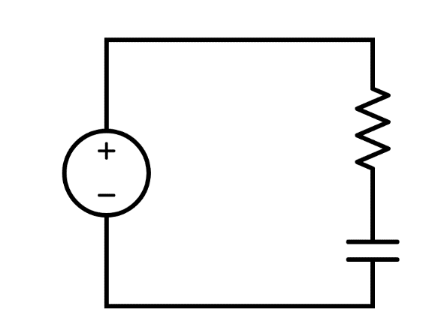
Series Resistor-Capacitor (RC) Circuit
$$\ln\left(V_{S}−v_{C}\right)−\ln\left(V_{S}\right)=\frac{−t}{RC}$$
R
V_{S}
$$\ln\left(\frac{V_{S}−v_{C}}{V_{S}}\right)=\frac{−t}{RC}$$
C
KVL
$$\frac{V_{S}−v_{C}}{V_{S}}=e^{{−t}/{RC}}$$
$$V_{s}=v_{R}+v_{C}$$
$$v_{R}=i_{R}R$$
Ohm's Law
$$i_{R}=i_{C}$$
KCL
$$v_{c}=V_{s}\left(1−e^{{−t}/{RC}}\right)$$
$$i_{C}=C\frac{dv_{C}}{dt}$$
Capacitive Current
The voltage across the charging capacitor as a function of time

Slide 11
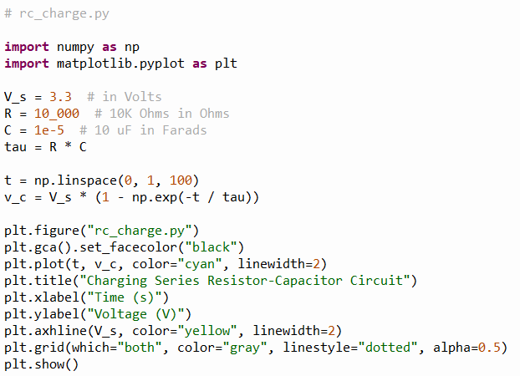

Our Solution
①
②
Model out to 1 sec
③
$$v_{c}=V_{s}\left(1−e^{{−t}/{RC}}\right)$$
④
Maximum Voltage
⑤
⑥
⑦
⑧
⑨
⑩

Slide 12
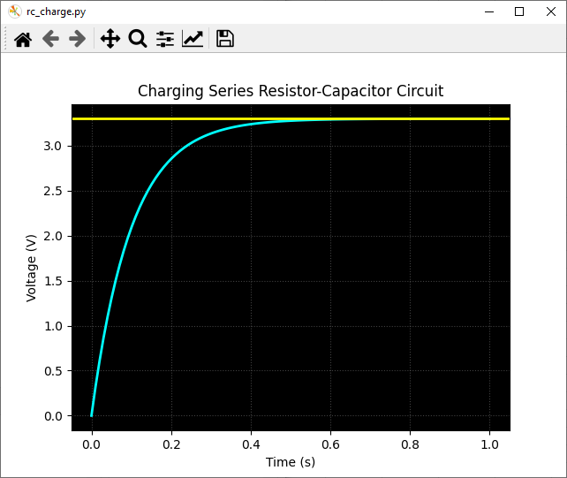
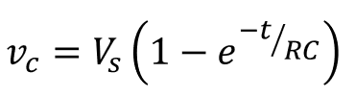
Our Result
3.3V Max

Slide 13
Team 01 – What We Learned
How to install and use Thonny & Python Packages – all are 100% free and open-source programming tools
How to create Numpy arrays and leverage vectorized operations
How to model the voltage over time of a discharging capacitor in an RC circuit
How to create a 2D line graph using Matplotlib and decorate that plot with axes labels and a title

